Slide 1
Automated Meeting Documentation
TEAM MEMBERS
Bibin Johny
Chithramol S. S
Rebecca Joshua
Razmil Minhaj
Vishnu C

Slide 2
CONTENTS
INTRODUCTION
FUNCTIONAL DIAGRAM
MODULE EXPLANATION
SPEAKER RECOGNITION
SPEECH TO TEXT
ACTION ITEM DETECTION
SUMMARY GENERATION
SEQUENCE DIAGRAM
PREREQUISITES
FUTURE SCOPE

Slide 3
INTRODUCTION
Automated Meeting Documentation is an application built on top of azure cognitive Services, Azure Chatbot and NLP libraries, to perform AI powered documentation tasks related to multi-person meetings. The app automatically records and structures meeting conversations to generate a summary and detect action items from the meeting. It helps you stay focused on your meetings while the application can take care of the documentation tasks and identify action items for follow ups.
The application allows meeting participants to view a compilation of summary and action items together in a meeting. The meeting software can convert speech to text as conversational output with time information, to recognize who spoke when, and generate summary and identify action items. It has the ability to produce summary published within seconds after the meeting.

Slide 4
Functional Diagram

Slide 5
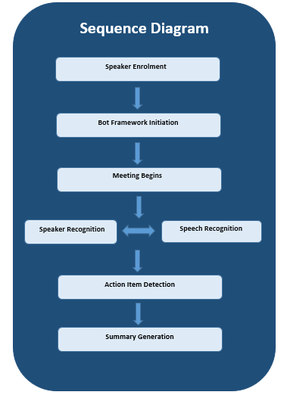
Sequence Diagram

Slide 6
SPEAKER RECOGNITION
Speaker recognition module is implemented using Microsoft Azure API
The streaming audio sample is sampled to different chunks which is to identified frequently using API to identify speakers
The python packages used are pyaudio, pydub, wave.
Process involved
Enrollment
Identification

Slide 7
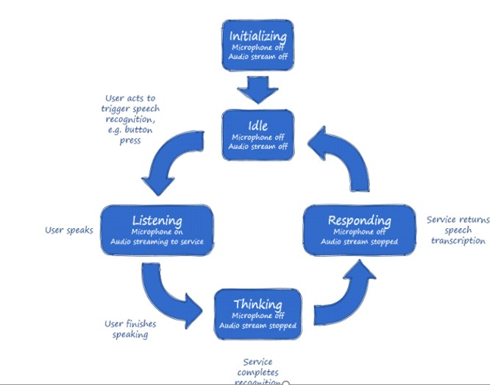
Speech to Text
The Speech to Text (STT), or speech recognition, API transcribes audio streams into text.
We have used the Microsoft Bing Speech API for our application

Slide 8
LUIS
Language Understanding (LUIS) is a cloud-based service that applies custom
machine-learning to a user's conversational, natural language text to predict overall
meaning, and pull out relevant, detailed information.
Natural Language Model
A model includes:
intents: categories of user intentions (intended action or result)
entities: specific types of data in utterances such as number, email, or name
example utterances: example text a user enters in the client application
In our Language model we have two intents namely
1 .action
2. None

Slide 9
Summary Generation
Text summarization works on the basis of text extraction method. The code is written in Python and uses Python Gensim library.
The code summarizes individual conversations first, then the entire meeting script is summarized.
Text file formed is formatted to give a conversational output.
The main feature of the code is that user can adjust the ratio, which is the percentage of input to be displayed as summary.

Slide 10
PREREQUISITES
Azure Subscription Keys for
1 Speaker recognition
2 Bing Speech Service
LUIS
Install Python packages
Visual Studio 2017
Bot Framework Emulator v4

Slide 11
Future Scope
The bot can be integrated with outlook to send and receive emails.
The system can be integrated with Skype (but currently skype does not allow chatbots in multi-person meetings) to read out the agenda and get more accurate information about who is speaking at a particular time.
The bot will be able to send mails to all participants once the bot is integrated with Outlook.
Improvement in speaker recognition technology will make the system more robust.
Further NLP functionalities can be incorporated, which will make the system more effective. Improvements in the efficiency and effectiveness of text summarization algorithms will improve the meeting summaries.

Slide 12
THANK YOU

